Slide 1
Moneyball Club Winter Quarter ‘20
Workshop Series: Predicting MLB MVP Odds
Part II: Webscraping Fangraphs for Baseball Statistics

Slide 2
Topics we wIll Go OVER
Recap webscraping
Let’s get started: (Picking up from last week)
Cleaning Data
Use same steps on different site
Make the computer do your repetitive tasks (for loops)

Slide 3
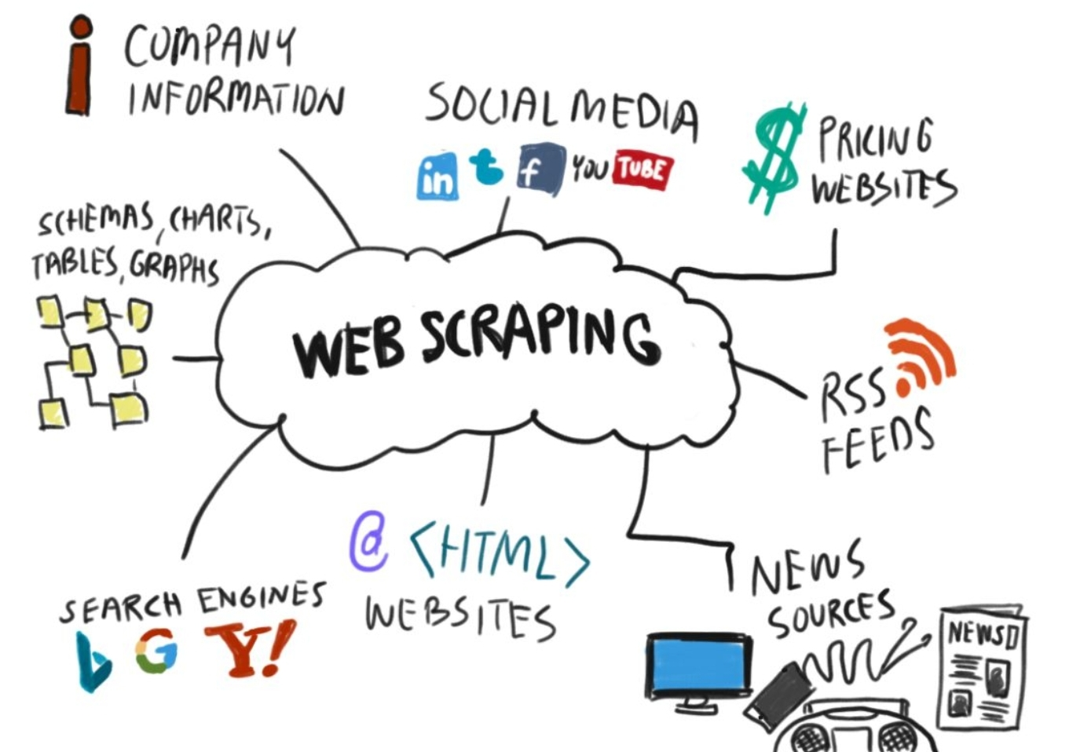
Why Do we Webscrape?
Purpose:
Collect Information from a website
When to use:
Data is not readily available
Applications:
Price comparison,
Email address gathering,
Social Media,
Job Listings,
Housing,
Sports!

Slide 4
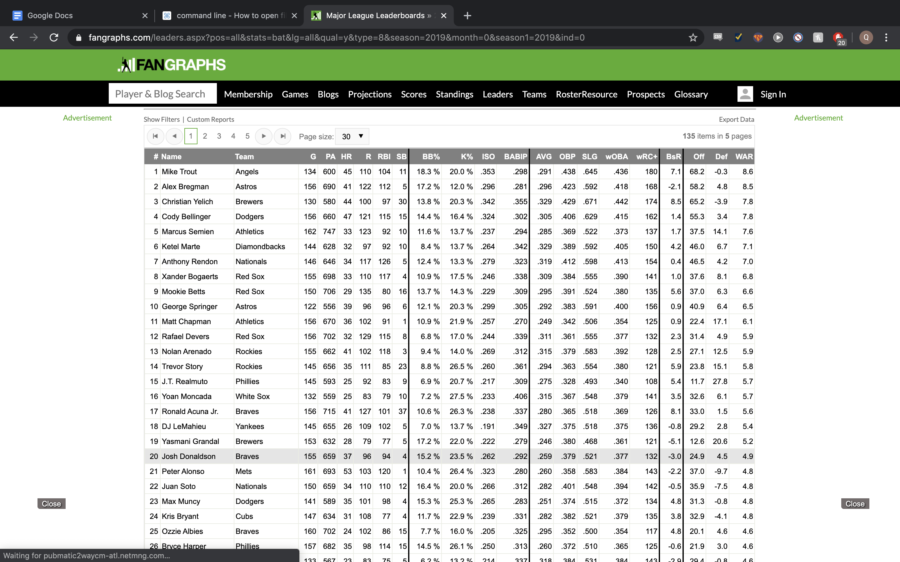

Slide 5
Problem
You really wanna get an internship this summer. The job fair is coming up. You look at your resume, and what do you find? Your project section is empty! So you begin to think about what kind of project you want to do. And you come across the idea of predicting the odds of future MVP players. You now begin to search online to find who the past MVP players are. You search for nice excel files that contain the data on the MVP players, but no luck. So what do you do now? Should you manually type all MVP players for the past century, do you give up and try a new project? Moments before giving up, you come across a Wikipedia page that contains everything you need! But how do you get this data?
Link : https://en.m.wikipedia.org/wiki/Major_League_Baseball_Most_Valuable_Player_Award

Slide 6
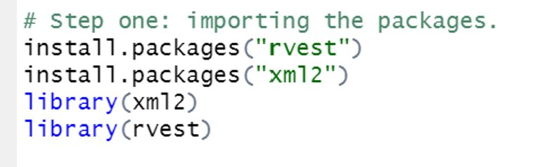
Step 1: Import Modules
Difficulty: Easy
English: "Take code someone else use and use it for yourself"
Purpose: Use already existing code to do the work (“Someone wrote instructions, you just got to tell someone else what they are”)

Slide 7
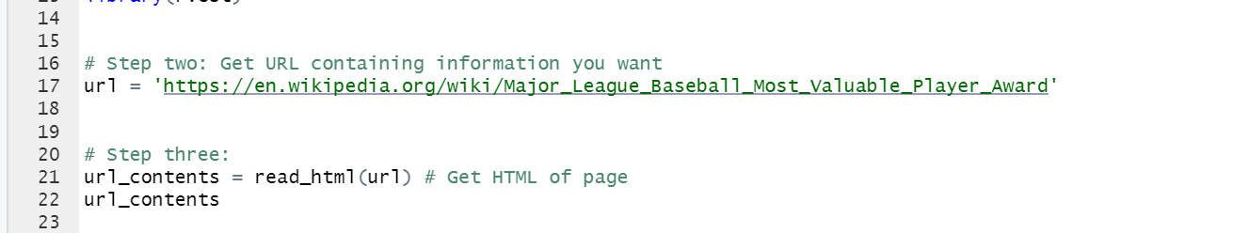
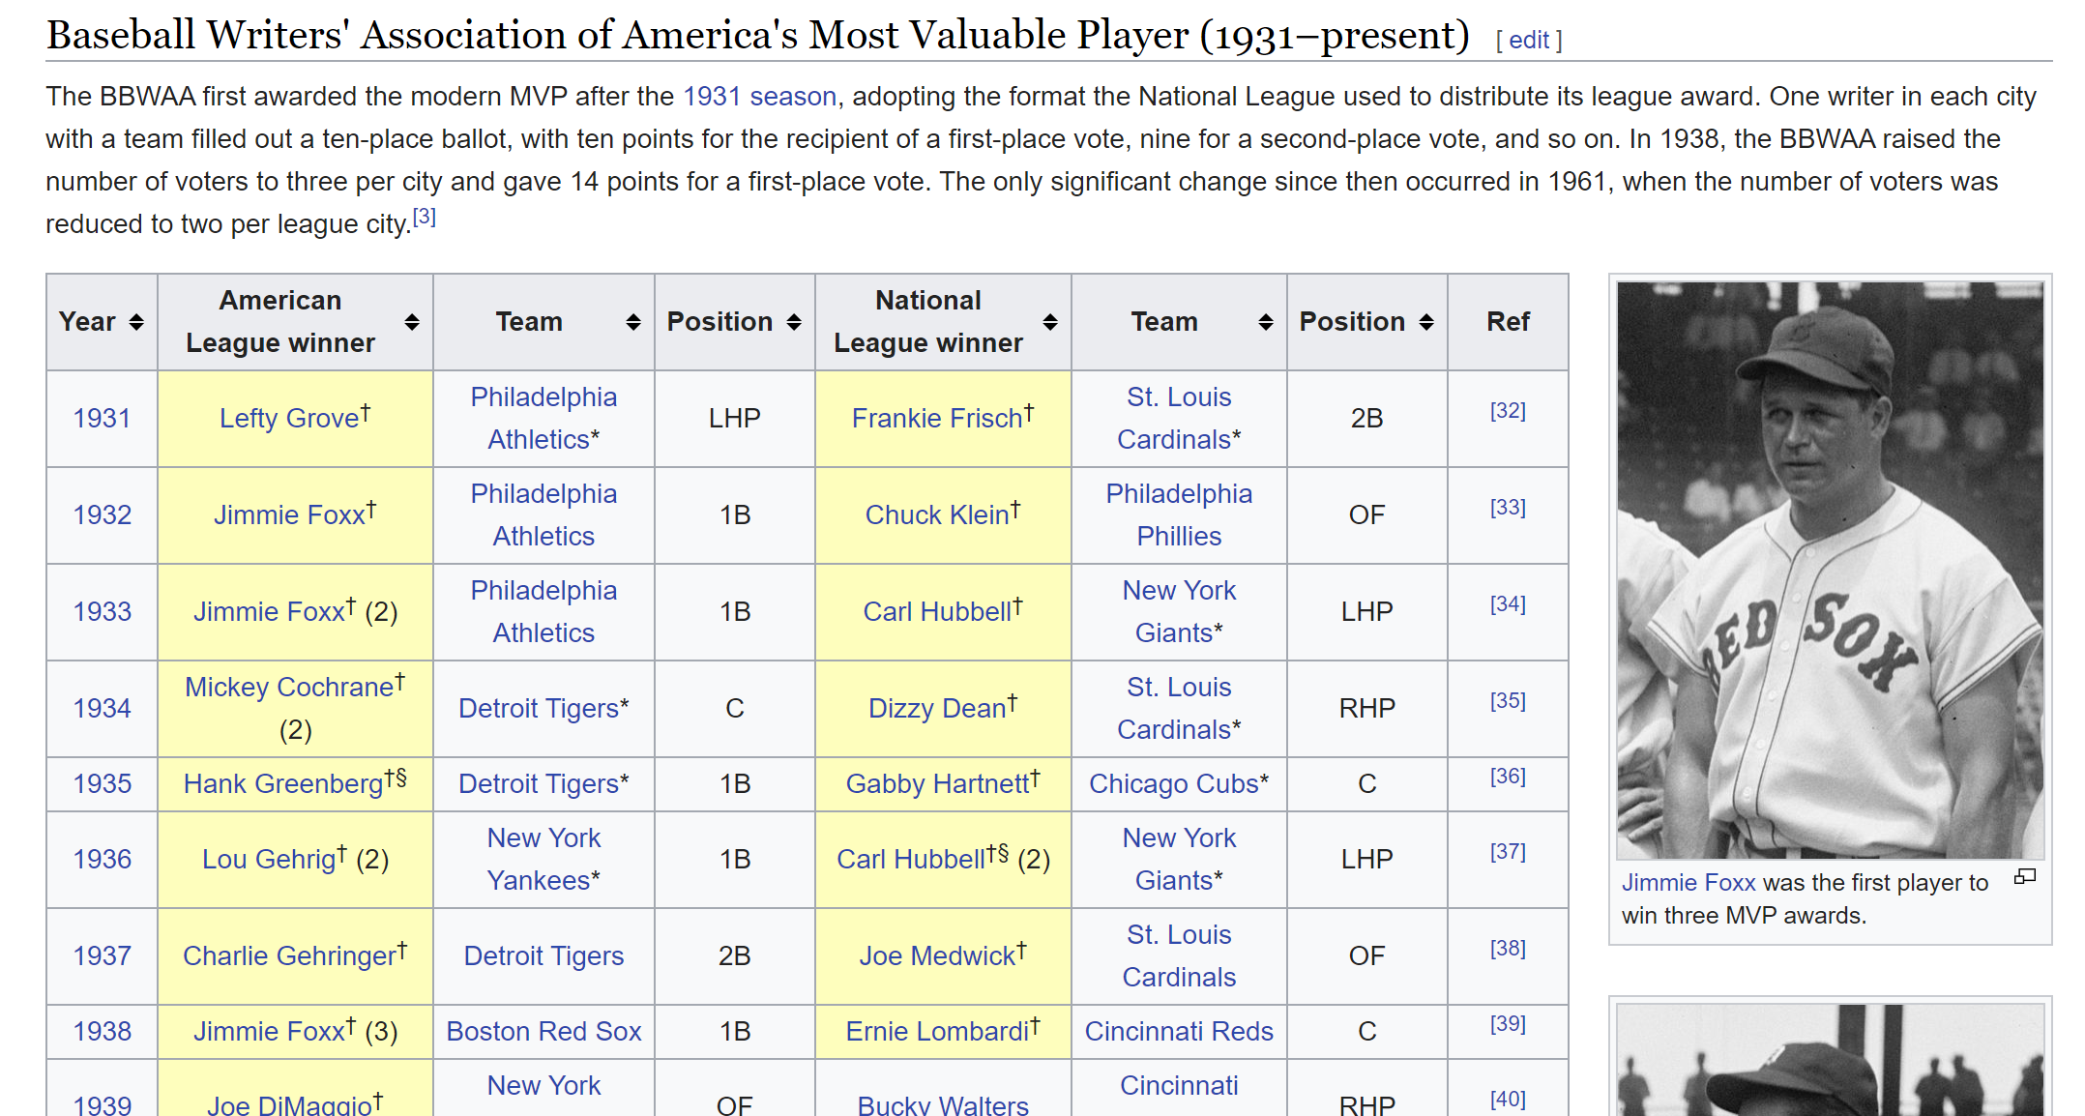
Step 2: Get Website HTML Contents
Difficulty: Very Easy
Purpose: Finding the data you want to extract
Source: https://en.wikipedia.org/wiki/Major_League_Baseball_Most_Valuable_Player_Award

Slide 8
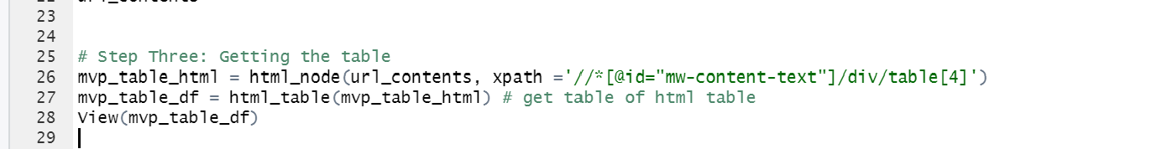
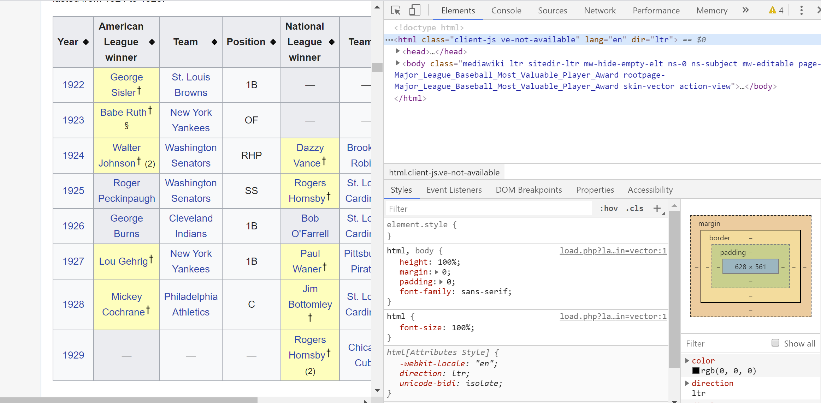
Step 3: Get Table
Code Reference:
Difficulty: Looks Hard, but easy
Purpose: Convert from html to data frame
Step 1: Inspect
Step 2: Find Table
Step 3: Get path to HTML Node (element)
Picture Reference:

Slide 9

Step 3: Get Table
Code Reference:
Difficulty: Looks Hard, but easy
Purpose: Convert from html to data frame
Step 1: Inspect
Step 2: Find Table
Step 3: Get path to HTML Node (element)
Picture Reference:

Slide 10
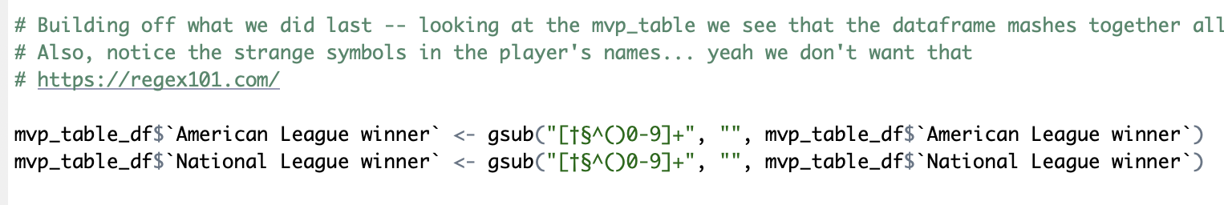
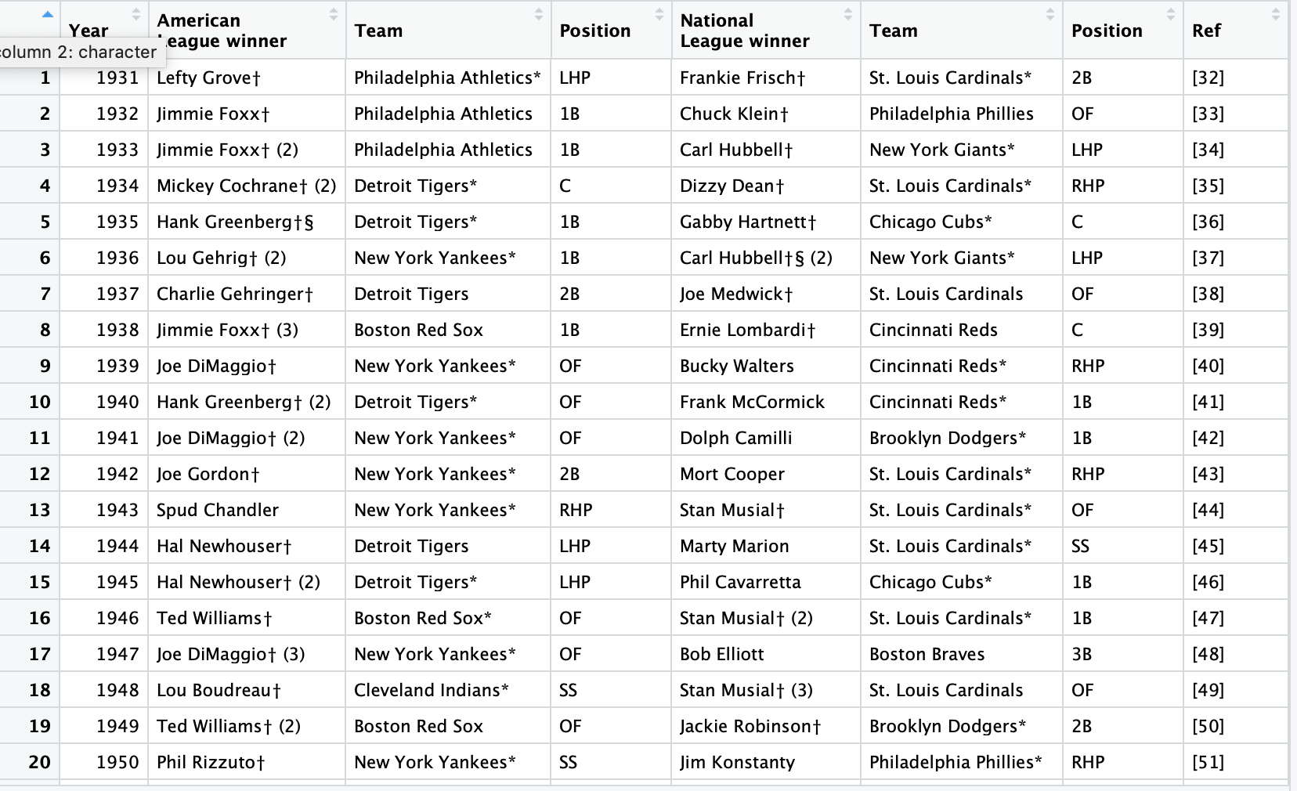
Step 4: Clean your data
Code Reference:
Difficulty: Simple concept, but hard at first
Purpose: Remove unwanted characters from your columns
Step 1: Identify unwanted character
Step 2: Create your regex pattern
Step 3: Use gsub function
Picture Reference:

Slide 11
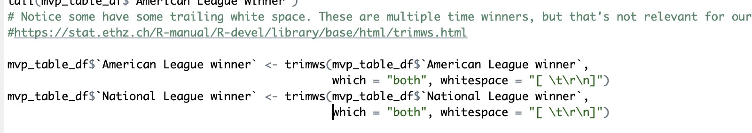
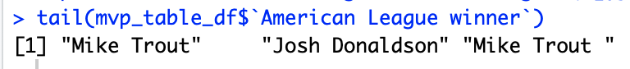
Step 4: Clean your data
Code Reference:
Difficulty: Easy
Purpose: Remove trailing and leading whitespace
Step 1: Use trimws functions (Use ?trimws for help)
Picture Reference:

Slide 12
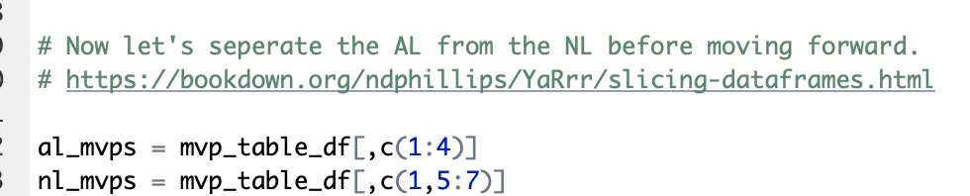
Step 4: Clean your data
Code Reference:
Difficulty: Simple concept, but hard at first
Purpose: Remove unwanted characters from your columns
Step 1: Identify columns you want (or don’t want)
Step 2: Use slicing notation
df[rows,columns]
Step 3: Assign to a new variable
Picture Reference:
Note! This also works for strings, matrices, vectors, etc!

Slide 13
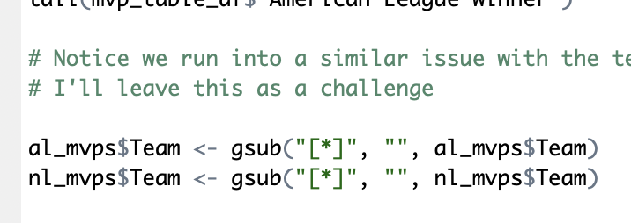
Step 4: Clean your data
Code Reference:
Difficulty: Simple concept, but hard at first
Purpose: Remove unwanted characters from your columns
Step 1: Identify unwanted character
Step 2: Create your regex pattern
Step 3: Use gsub function
Similar problem with the Teams. Try it yourself!
Picture Reference:

Slide 14

Step 4: Clean your data
Code Reference:
Difficulty: Simple concept, but hard at first
Purpose: Remove unwanted characters from your columns
Step 1: Identify unwanted character
Step 2: Create your regex pattern
Step 3: Use gsub function
Similar problem with the Teams. Try it yourself!
Picture Reference:

Slide 15
Problem
You really wanna get an internship this summer. The job fair is coming up. You look at your resume, and what do you find? Your project section is empty! So you begin to think about what kind of project you want to do. And you come across the idea of predicting the odds of future MVP players. You now begin to search online to find who the past MVP players are. You’ve gathered data on who the MVP winners are but you don’t know why they won it! You search for nice excel files that contain the data on the MVP players, but no luck. You try the Lahman dataset in R but it doesn’t have all the statistics you wanted. So what do you do now? Should you manually type copy and paste baseball statistics from the past 80 years to get a whole picture of the league? Moments before giving up, you come across Fangraphs, your home for baseball statistics and analytics! But how do you get this data?
Link : Fangraphs

Slide 16
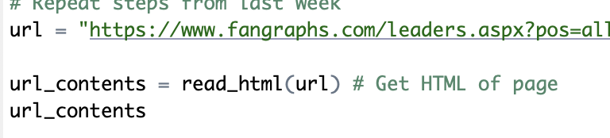
Step 5: Get Website HTML Contents
Difficulty: Very Easy
Purpose: Finding the data you want to extract
Source: Fangraphs

Slide 17
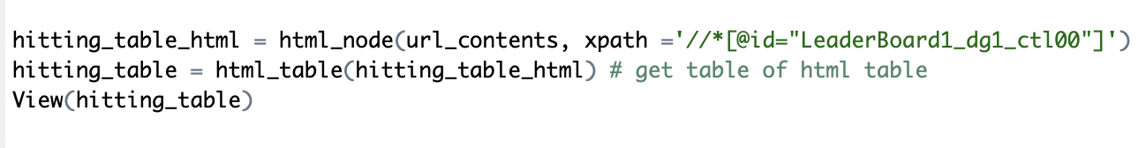
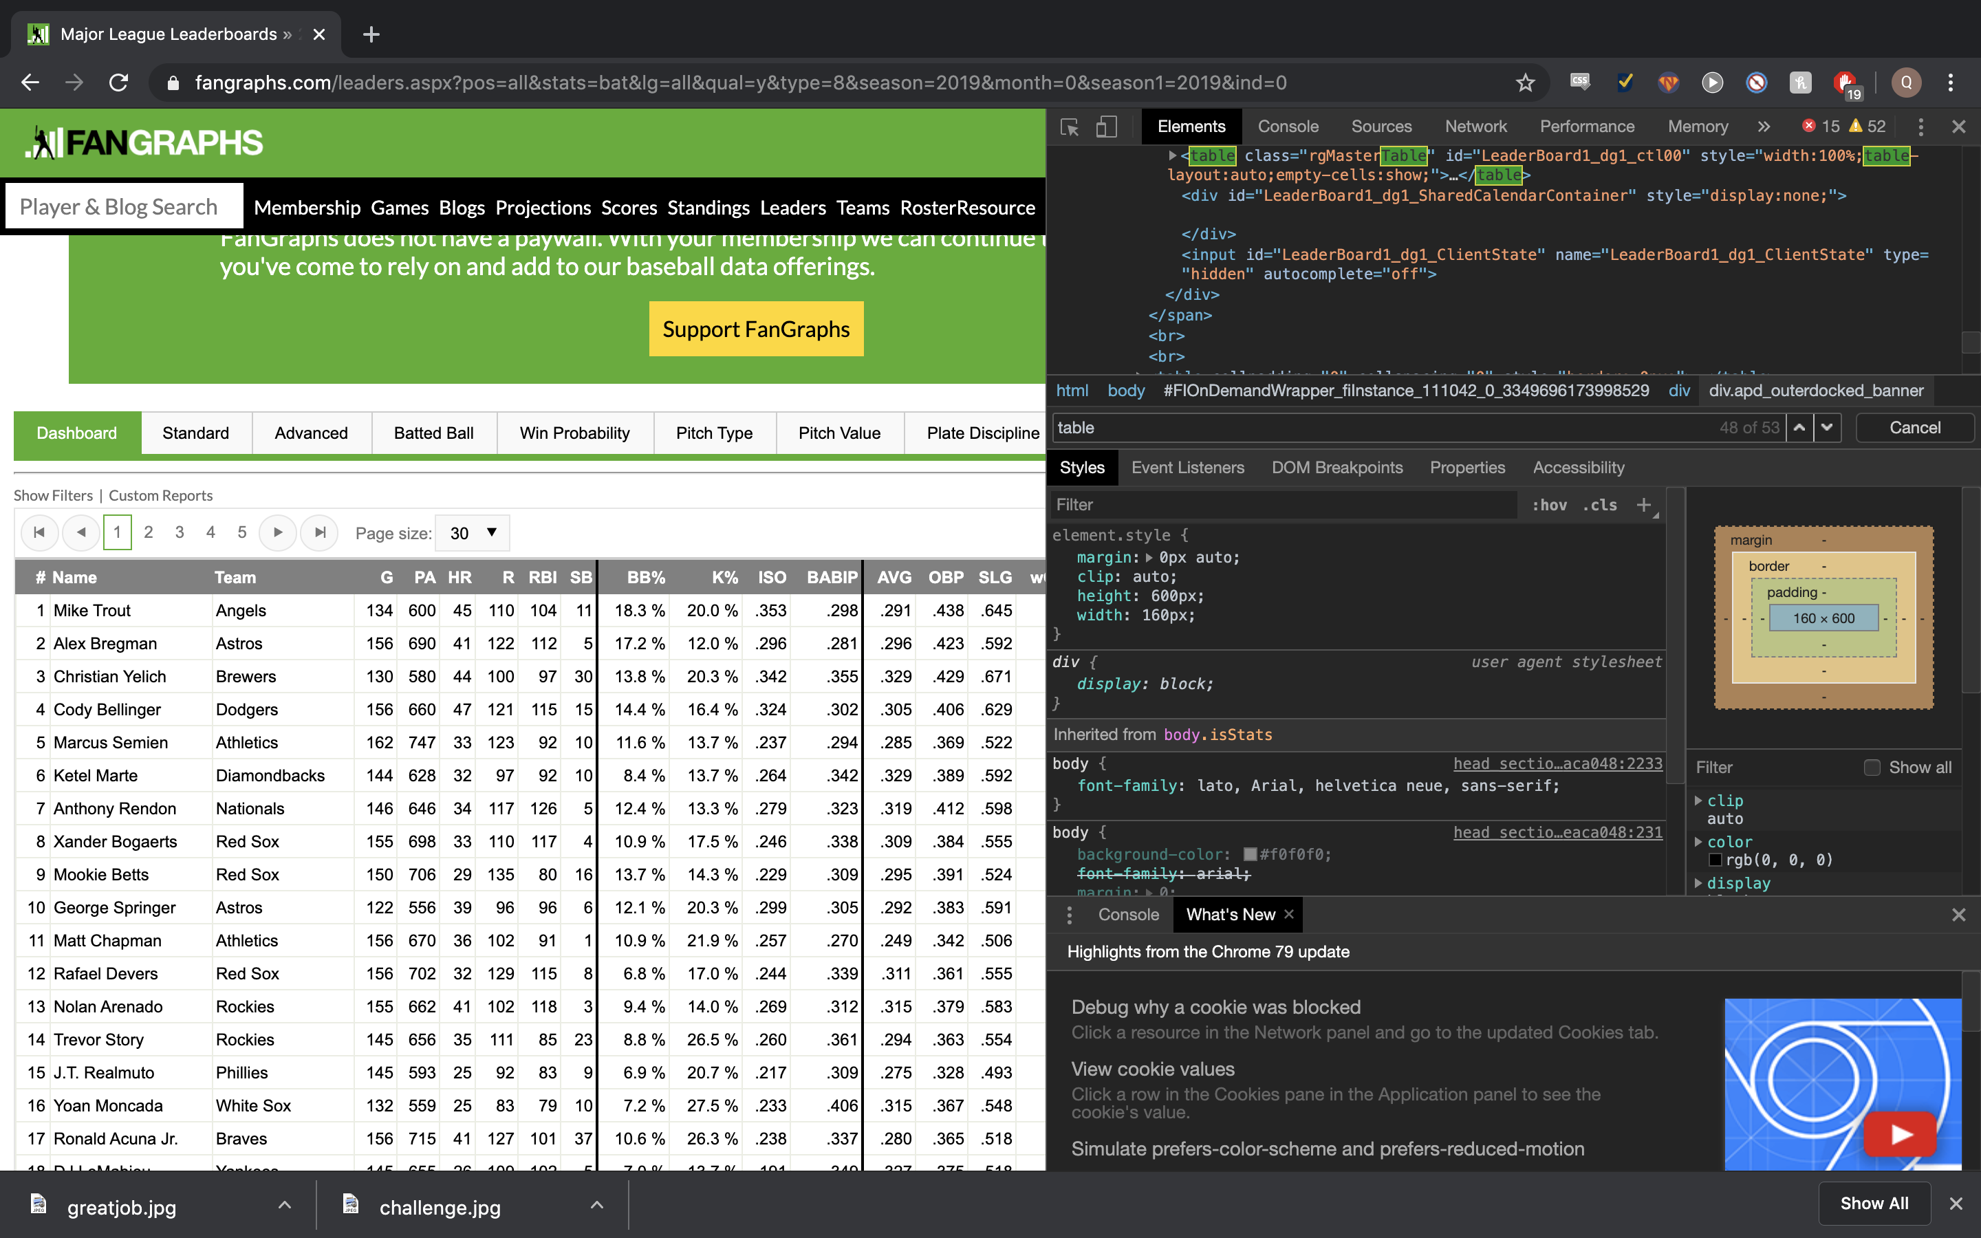
Step 6: Get Table
Code Reference:
Difficulty: Looks Hard, but easy
Purpose: Convert from html to data frame
Step 1: Inspect
Step 2: Find Table
Step 3: Get path to HTML Node (element)
Picture Reference:

Slide 18
Step 3: Get Table
Code Reference:
Difficulty: Looks Hard, but easy
Purpose: Convert from html to data frame
Step 1: Inspect
Step 2: Find Table
Step 3: Get path to HTML Node (element)
Picture Reference:

Slide 19
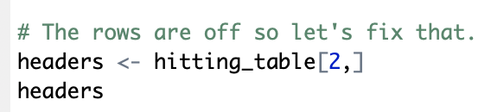
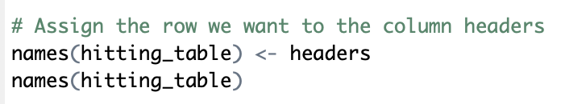
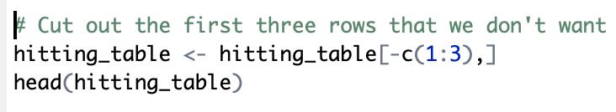
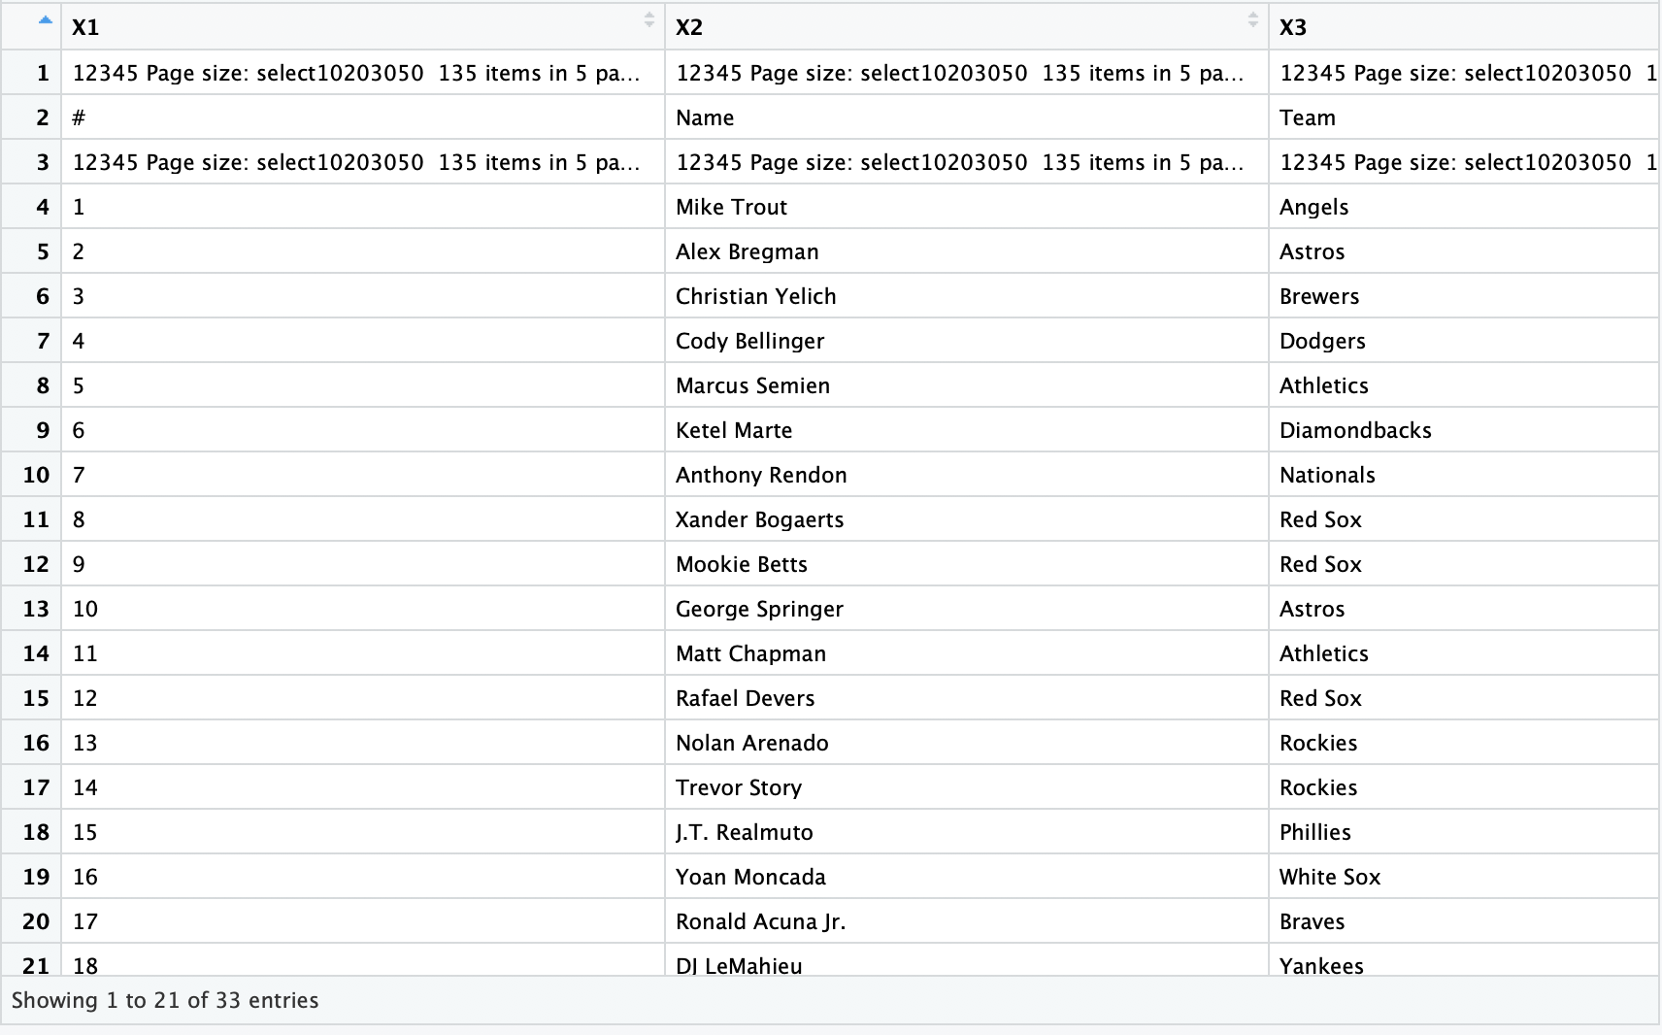
Step 7: Clean your data
Code Reference:
Difficulty: Easy if I’ve done my job right
Purpose: Change headers to proper variables
Step 1: Save dataframe row to a variable
Step 2: Assign the headers to the column names
Step 3: Cut out first three rows
Picture Reference:

Slide 20
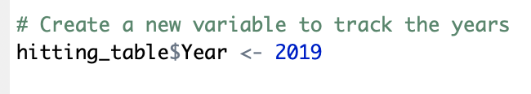
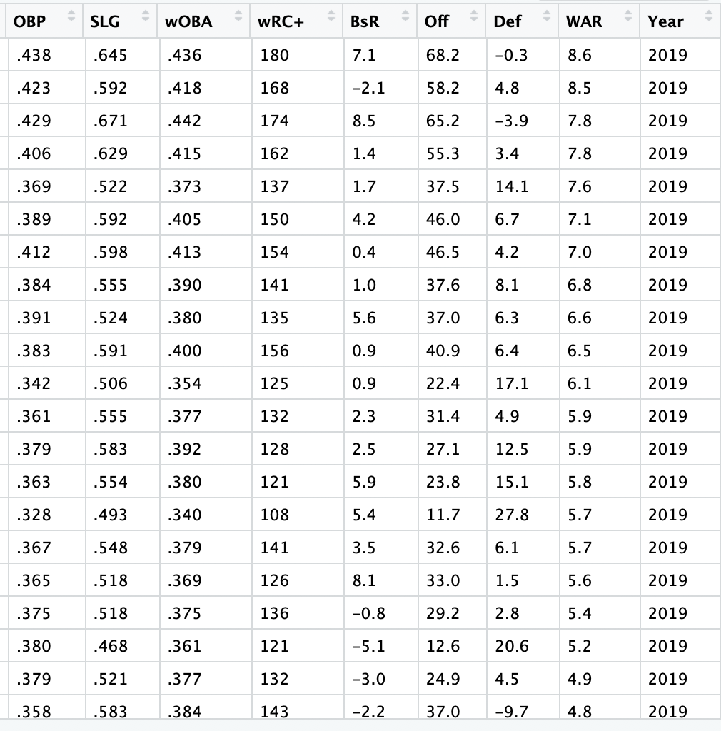
Step 7: Creating a variable
Code Reference:
Difficulty: Easy
Purpose: Keep which rows belong to which years
Step 1:
Create a new column with the value “2019”
Picture Reference:

Slide 21
Step 4: Clean your data
Code Reference:
Difficulty: Simple concept, but hard at first
Purpose: Remove unwanted characters from your columns
Step 1: Identify unwanted character
Step 2: Create your regex pattern
Step 3: Use gsub function
Similar problem with the Teams. Try it yourself!
Picture Reference:

Slide 22
Now let’s do that 87 more times
But wait?? That could take forever???

Slide 23
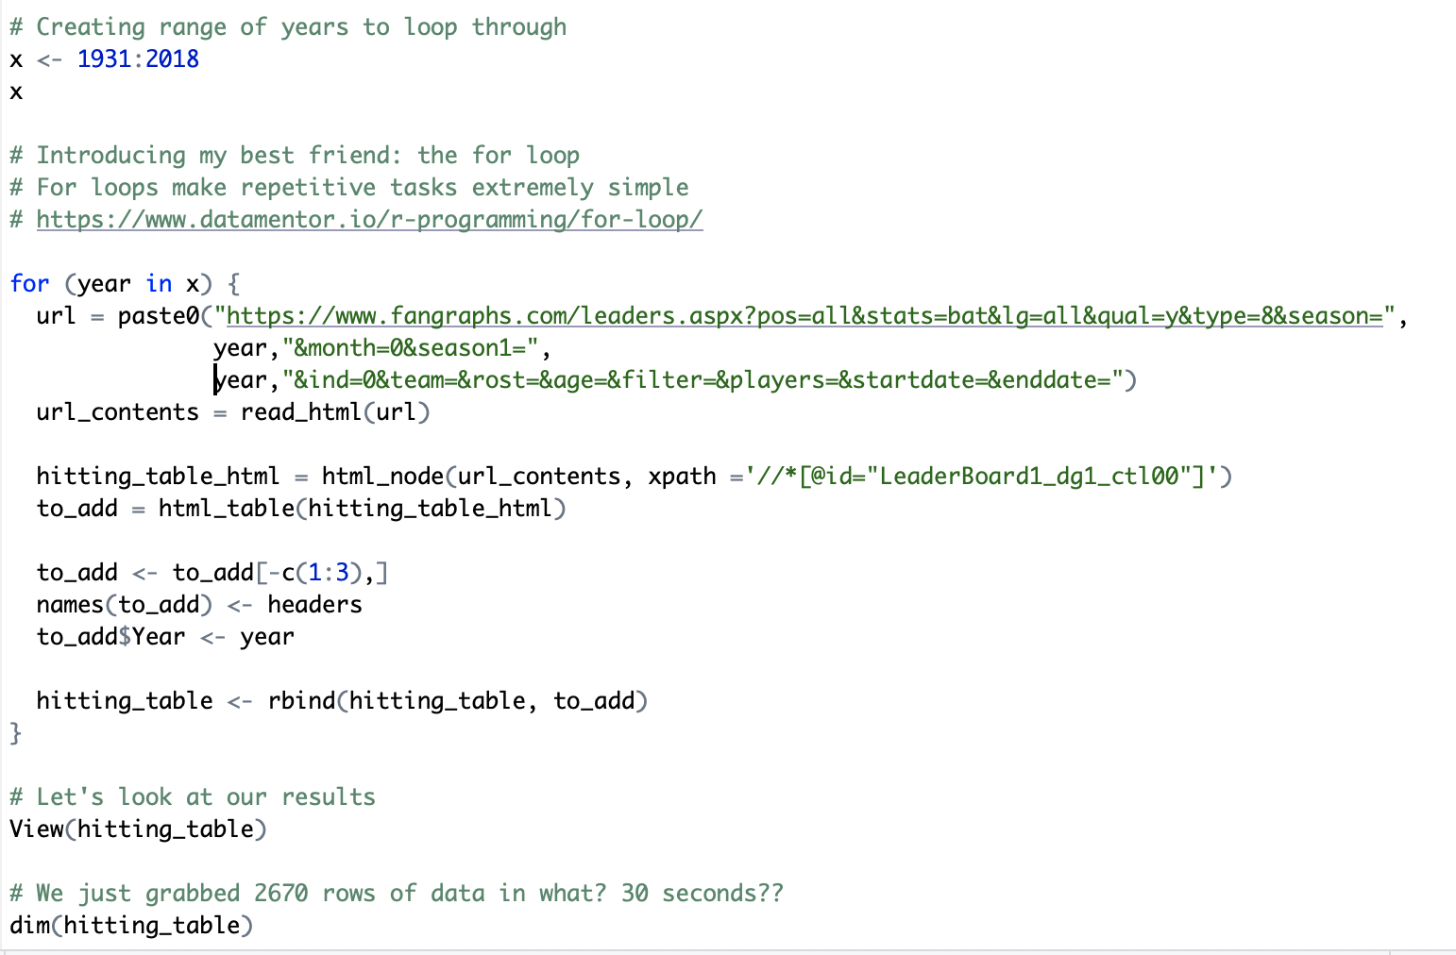
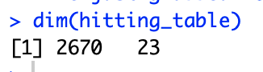
Step 8: For loops
Code Reference:
Difficulty: Moderate but makes life so much easier once you get it down
Purpose: To repeat tedious or repetitive processes n times
Step 1: Create a vector over the range you want to loop
Step 2: Write what you want repeated inside a “for loop” statement
Step 3: Tack on the additional dataframe your original dataframe
Note: You might get an error because Fangraphs recognizes it’s not a human... Just visit the website and confirm you’re not a robot
Picture Reference:

Slide 24
Reflection
1) Do you see how reusable code/skills are?
2) Did you learn something new about webscraping?
3) What is the purpose of ”for loops”?

Slide 25
Resources
Python:
https://pandas.pydata.org/pandas-docs/stable/user_guide/indexing.html
https://www.w3schools.com/python/python_for_loops.asp
https://realpython.com/python-thinking-recursively/
R
Links in R script
https://towardsdatascience.com/learn-to-create-your-own-datasets-web-scraping-in-r-f934a31748a5
https://www.regular-expressions.info/ (all languages)

Slide 26

What's NExt

Slide 27
Challenge
Extract the pitching and fielding data into a dataframe in R.
Remember the steps:
Import Modules
Get Website HTML Contents
Get Table
For Loop
Link : Fangraphs

